Slide 1
Tuesday Next Talks
● ● ● ● ● ● ● ● ● ● ● ● ● ● ● ● ● ● ● ● ● ● ● ●

Slide 2
LinkedIn for Entrepreneurs
DIANTHE SKURKO
dianthe@extremebrandbuilder.com
Notes:
Quick overview of branding vs personal branding

Slide 3
Branding Yourself on LinkedIn
Optimize your profile
Make meaningful connections
Create compelling content
DIANTHE SKURKO Extreme Brand Builder

Slide 4
Company Brand vs. Personal Brand
DIANTHE SKURKO Extreme Brand Builder

Slide 5
Company Brands
DIANTHE SKURKO Extreme Brand Builder
Notes:
A brand is an identity that includes logos, typography, colors, packaging, and messaging, and it complements and reinforces the existing reputation of a brand. Brand identity attracts new customers to a brand while making existing customers feel at home.

Slide 6
What’s a Personal Brand?
DIANTHE SKURKO Extreme Brand Builder
Notes:
So what is a personal brand then and how does it pertain to my business?

Slide 7
Notes:
THE VIRGIN NAME AND LOGO HAS BECOME RENOWNED FOR PROVIDING A UNIQUE AND EXCEPTIONAL CUSTOMER EXPERIENCE.

Slide 8
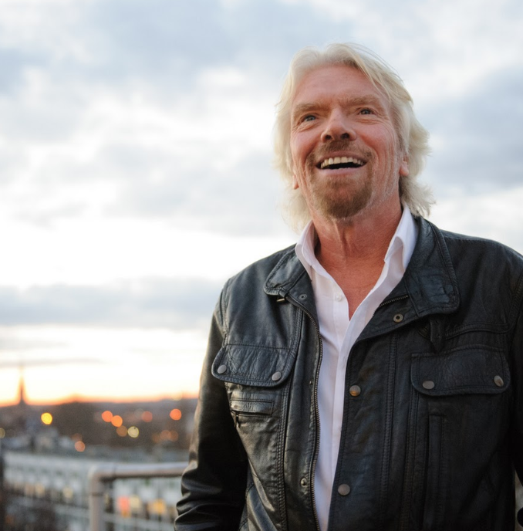
Notes:
People talk about brand consistency, brand honesty, all those other synonyms, but really when you stick to your principles, your brand instinctively follows suit and becomes whoever you are.

Slide 10
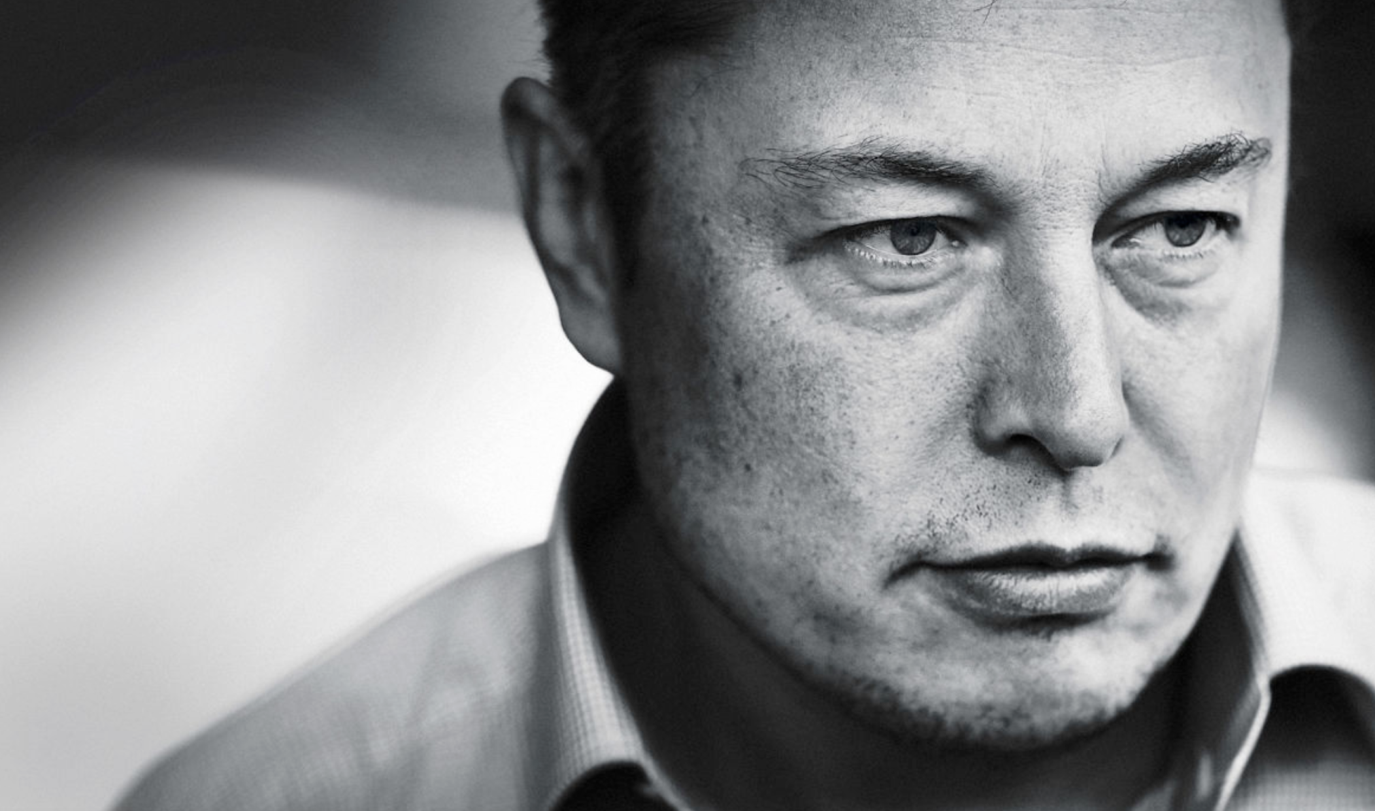
Notes:
Elon Musk is a bold visionary.

Slide 12
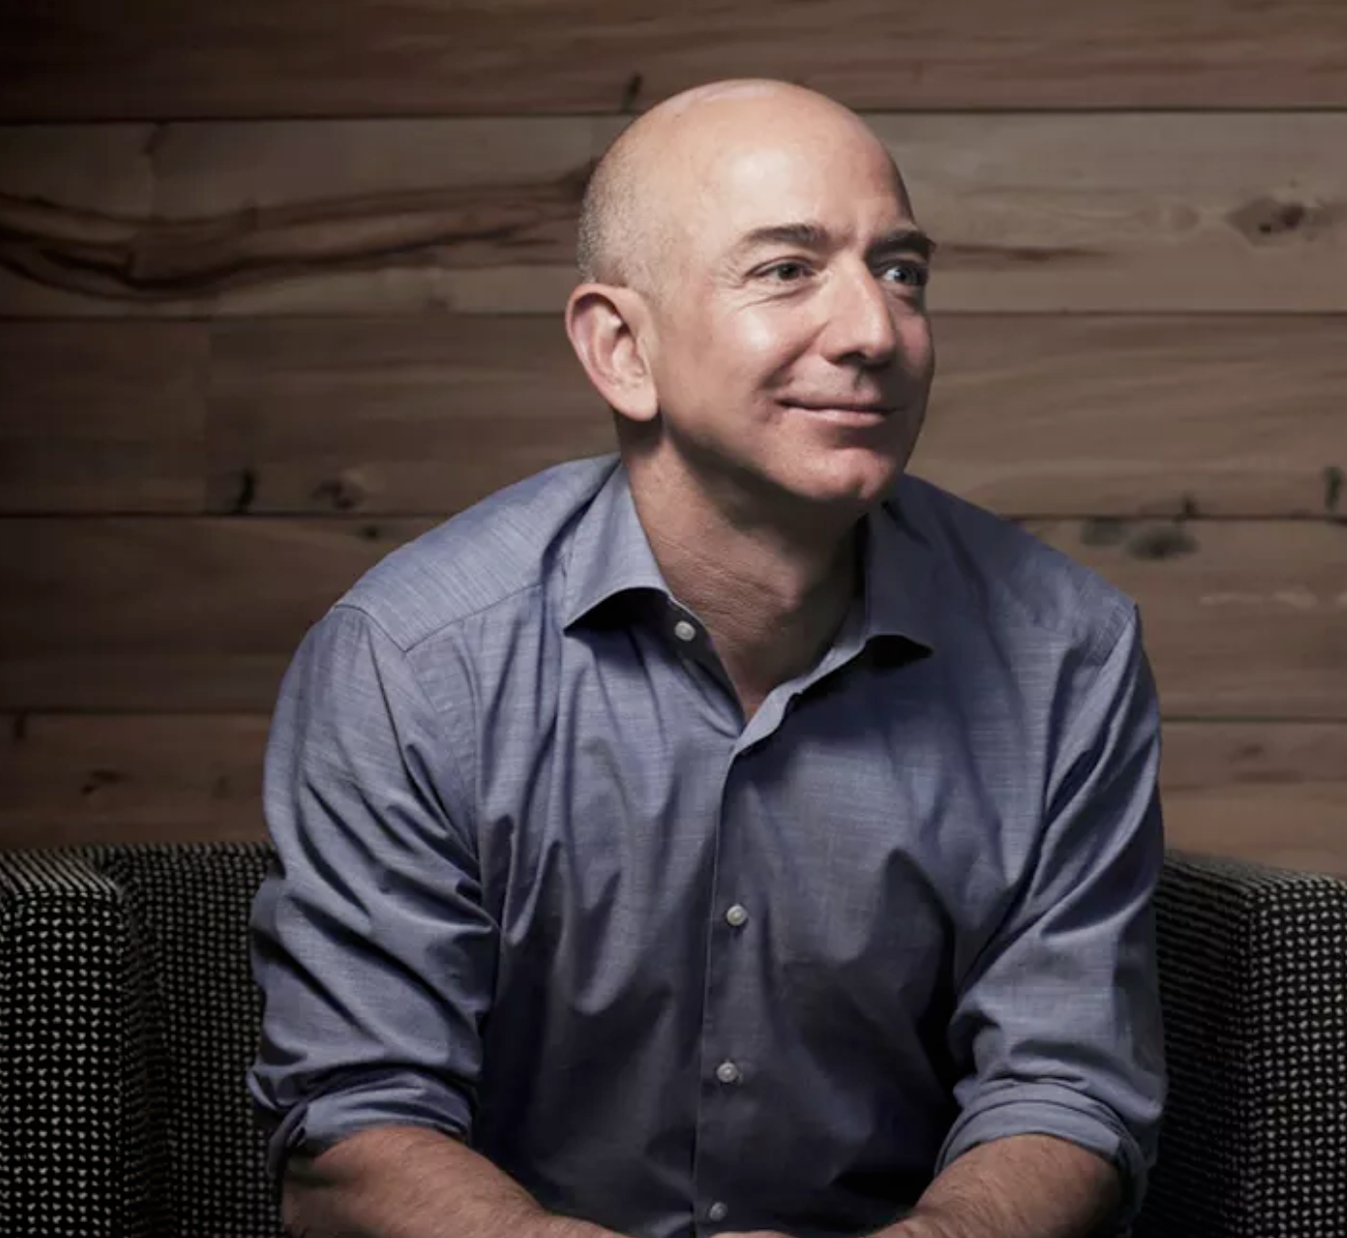
Notes:
Your brand is what other people say
about you when you're not in the room.
― Jeff Bezos
Frugal
Long-term
World domination

Slide 13
Benefits of a Strong Personal Brand
A thought leader in your field
A competitive edge
Have control over your career
The power to influence
Career opportunities
DIANTHE SKURKO Extreme Brand Builder

Slide 14
Building a Powerful Personal Brand
1. Find your “why”
2. Find your expert zones
3. Find your audiences
4. Choose your ideal audience
5. Define your objective
6. Create your tagline
DIANTHE SKURKO Extreme Brand Builder

Slide 15
People don't buy what you do; they buy why you do it.
DIANTHE SKURKO Extreme Brand Builder

Slide 16
Step 1: Find Your “Why”
DIANTHE SKURKO Extreme Brand Builder

Slide 17
I want to:
[what you want to contribute]
So that:
[the impact you want to make]

Slide 18
“I want to influence, empower, give purpose, and create success for entrepreneurs and the organizations they care about.”

Slide 19
Step 2: Find Your “Expert Zones”
Make a list of everything you’re an expert at
DIANTHE SKURKO Extreme Brand Builder

Slide 20
Step 3: Find Your “Audience”
Make a list of all the potential audiences interested in your unique skills otherwise known as the genius zone.

Slide 21
Step 4: Find Your “Ideal Audience”
Be like you
Have money
Want what you have (and be willing to pay for it)
Energize you

Slide 22
Step 5: Define Your Objective

Slide 23
I want ______________________
(your audience)
to __________________________
(action you want them to take)
so ___________________________
(impact you want).
DIANTHE SKURKO Extreme Brand Builder

Slide 24
I want _Executives_
(your audience)
To _use my branding and mentoring services_
(action you want them to take)
so _they can increase their visibility to investors, employers, and decision makers_.
(impact you want)

Slide 25
Step 6: Create Your Tagline
DIANTHE SKURKO Extreme Brand Builder

Slide 26
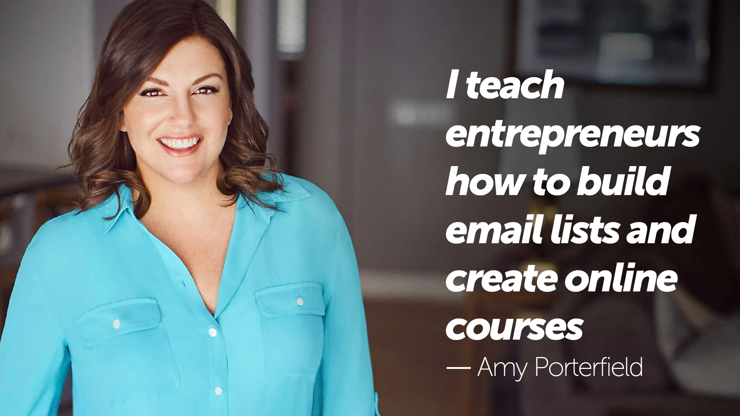
Your Tagline

Slide 27
My Tagline
“I create and implement brand strategies for future -thinking entrepreneurs.”

Slide 28
Your Tagline
I __________________________
to __________________________.

Slide 29
Review: Building a Powerful Personal Brand
1. Find your “why”
2. Find your expert zones
3. Find your audiences
4. Choose your ideal audience
5. Define your objective
6. Create your tagline
Notes:
Review

Slide 30
Steps to Align and Optimize
Your LinkedIn Profile
Notes:
Members with complete profiles are 40x more likely to receive opportunities through LinkedIn.

Slide 31
Optimizing Your LinkedIn Profile
1. Profile photo
2. Title
3. Banner
4. Bio
5. Job history
6. Contact info
7. Recommendations
8. Skills
9. Public settings
10.Education

Slide 32
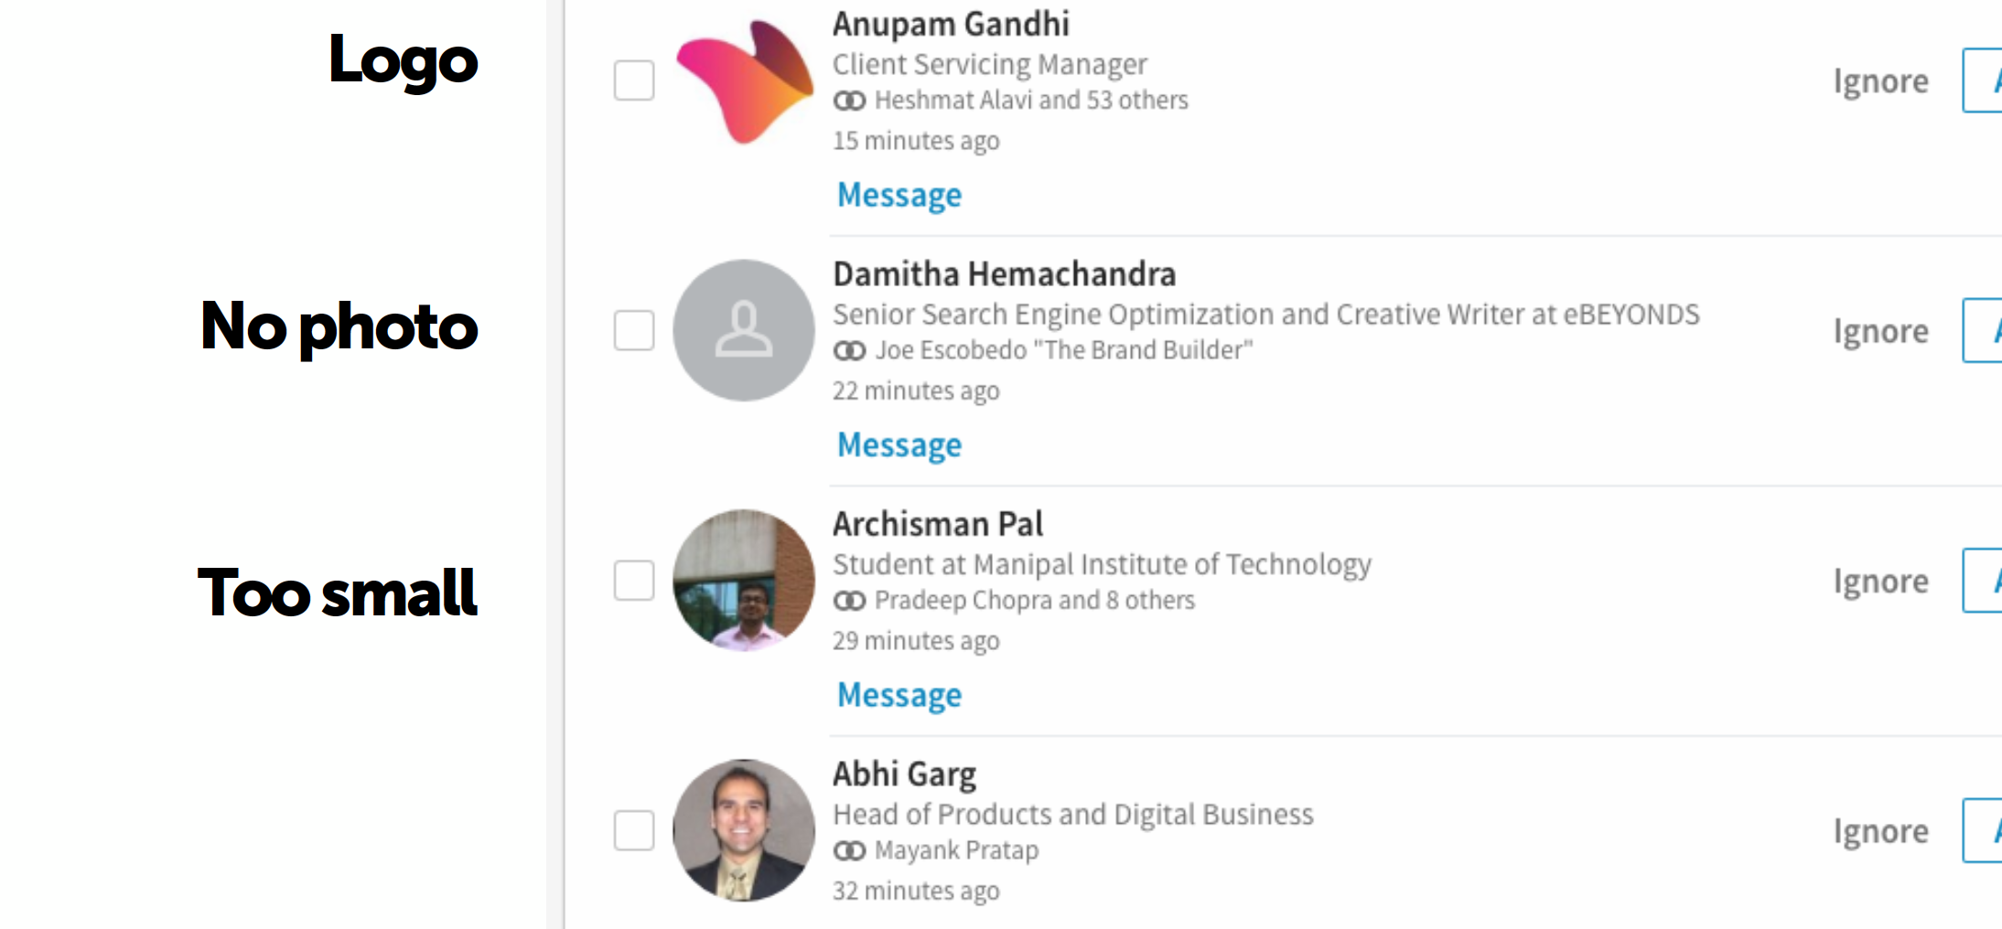
Profile Photos
Notes:
1. The No Photo
2. The Group
3. The Logo
4. The Product
5. The Low Res
6. The Crop
7. The Squeeze
8. The Tiny Person
9. The Millionaire
10. The When-I-Had-Hair

Slide 33
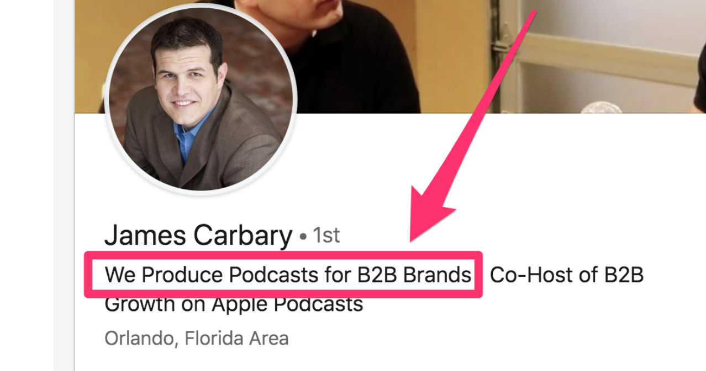
Make Sure Your Title is on Brand

Slide 34
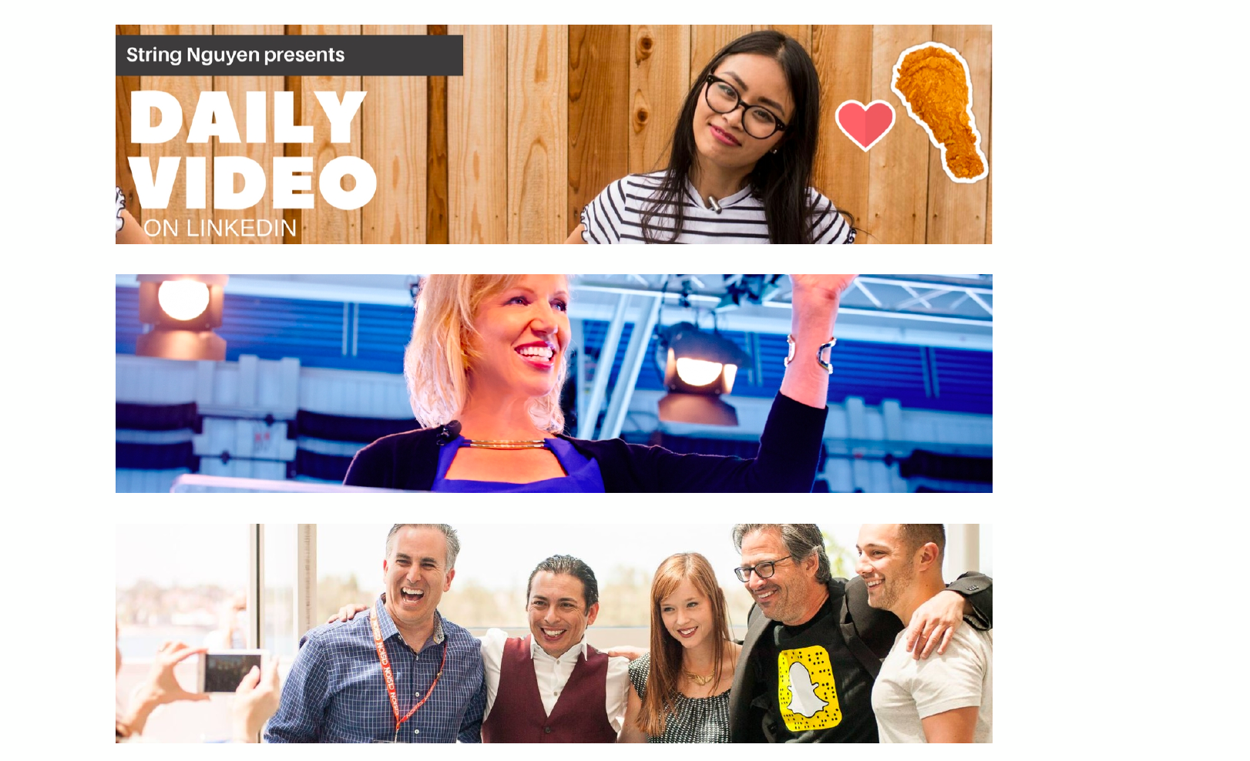
The Banner

Slide 35
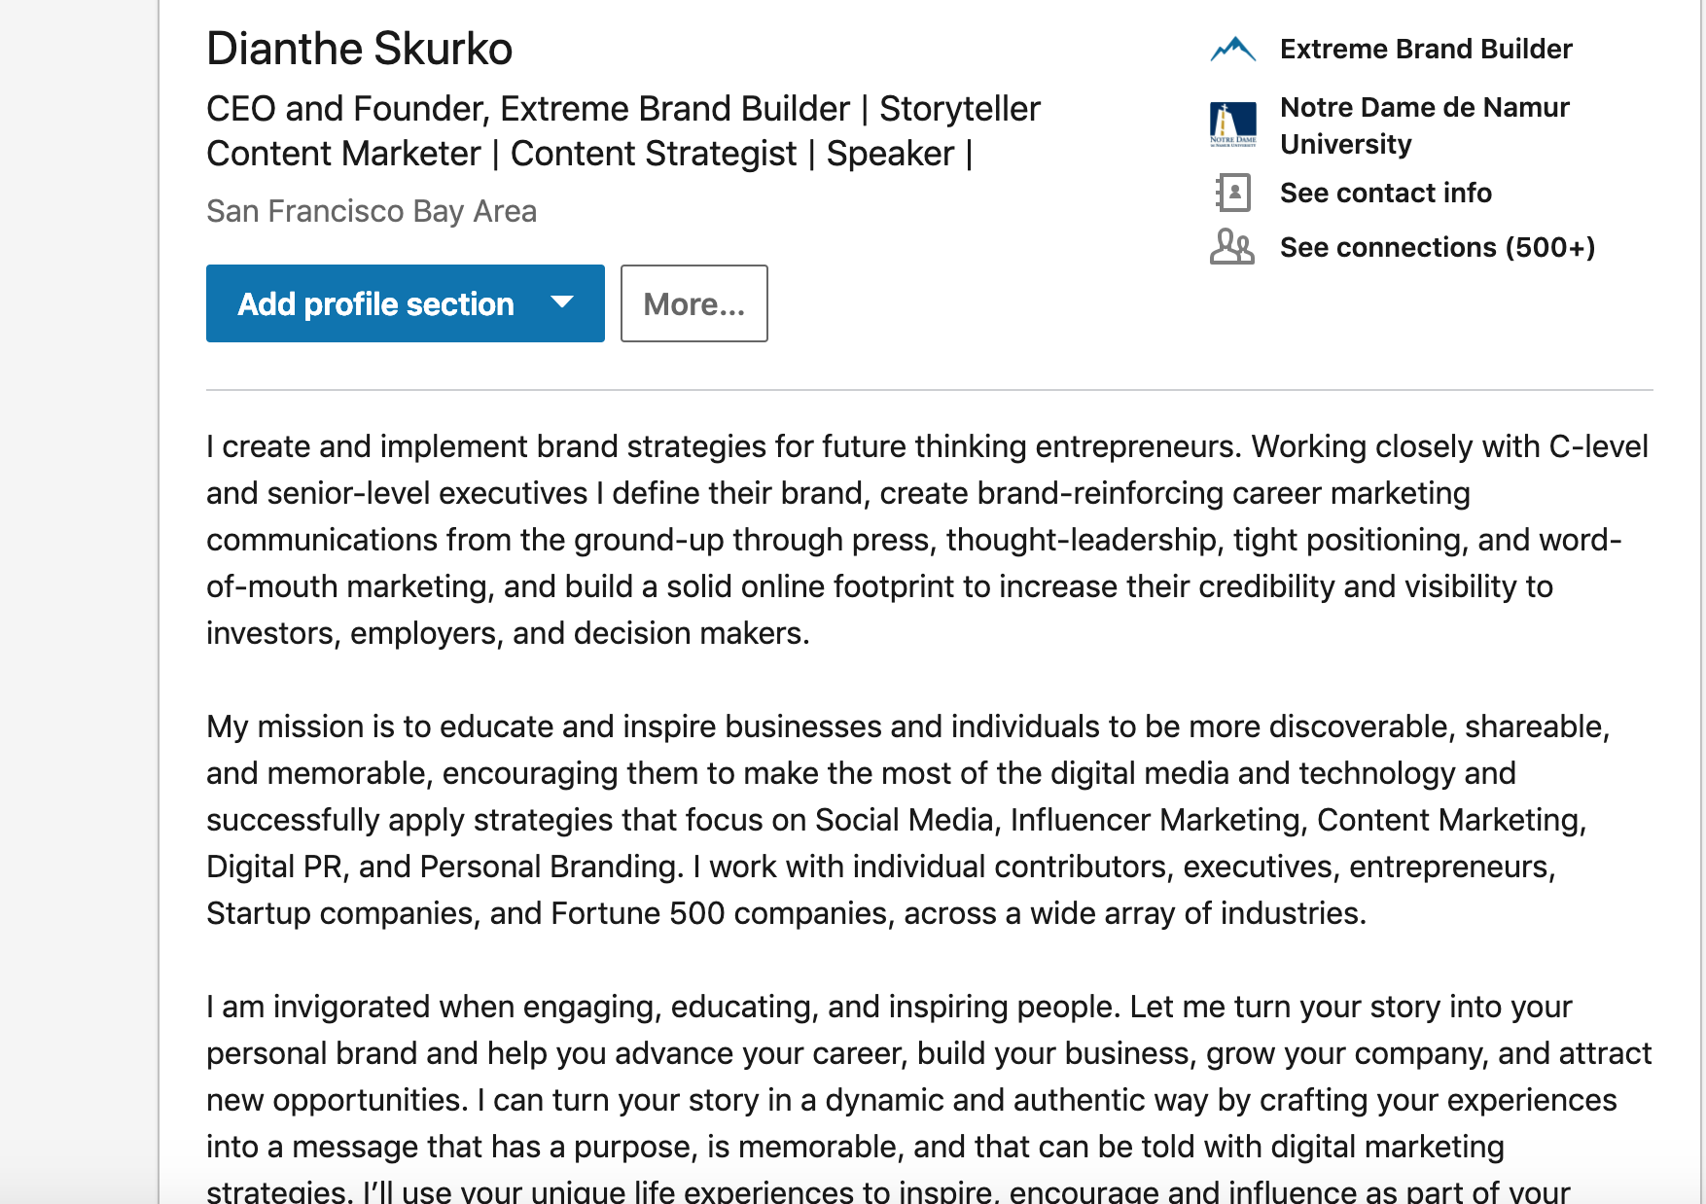
Your Bio - Make the First Lines Count
Notes:
Write in first person
Don’t leave anything blank
Don’ post a company description.

Slide 36
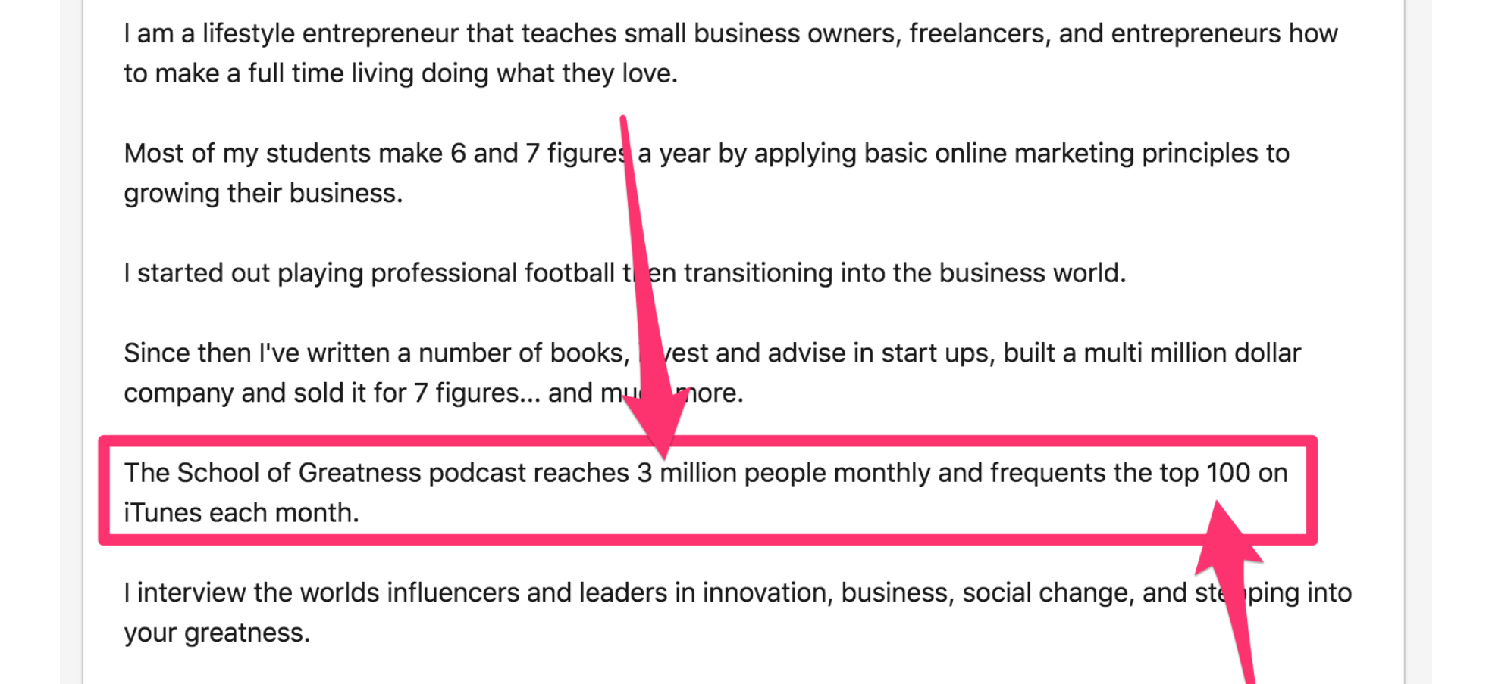
Don’t tell us how awesome you are, show us.
Notes:
4. Use keywords in your descriptions
5. Employment History
Tell stories
List factual accomplishments
Keywords

Slide 37
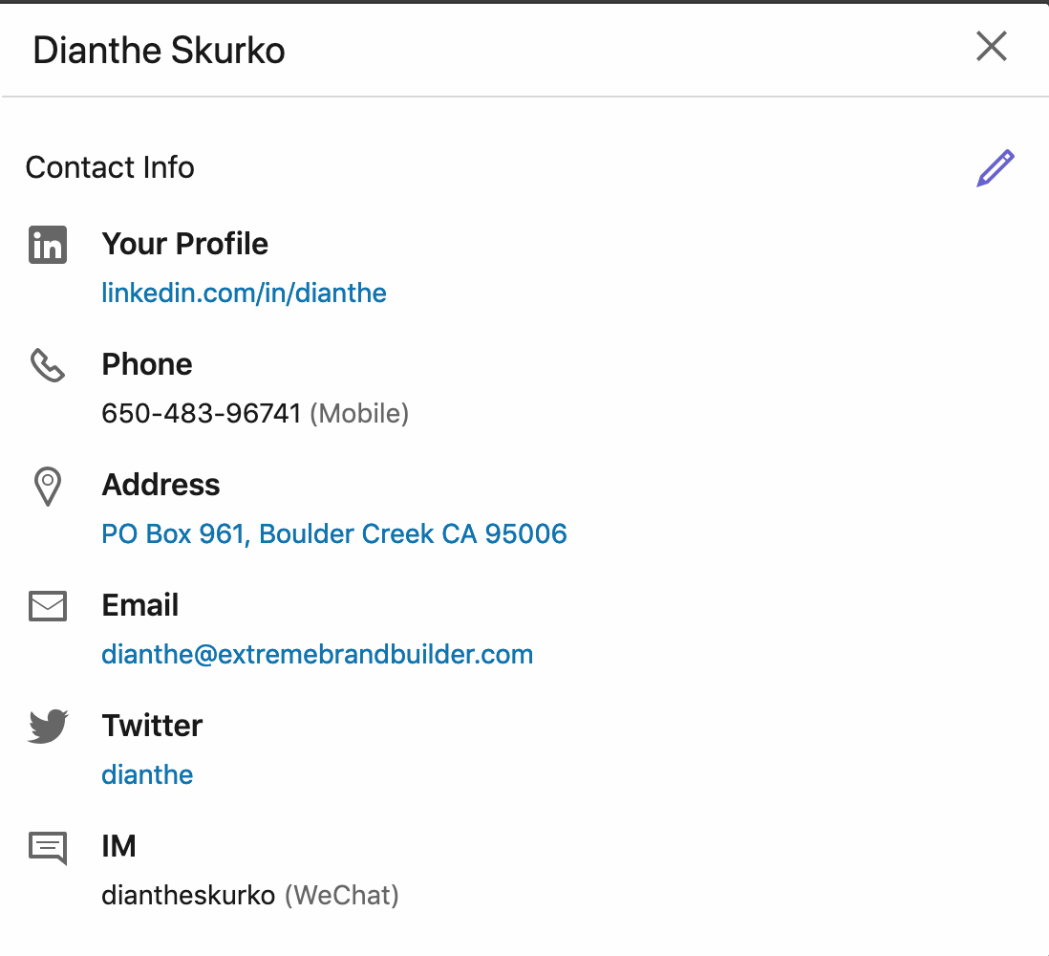
Contact & Personal Info

Slide 38
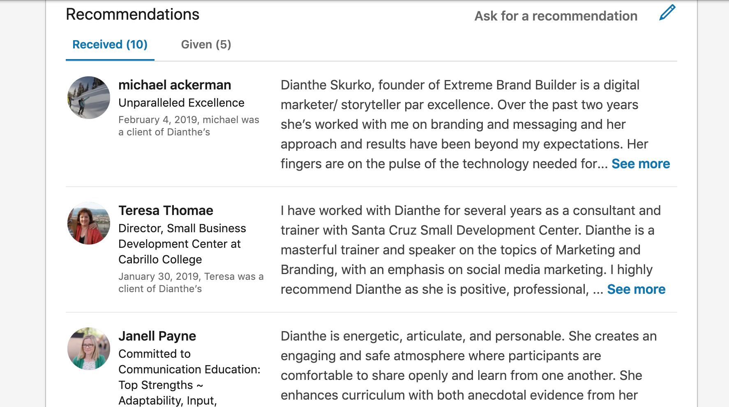
Recommendations
Notes:
Ask for recommendations

Slide 39
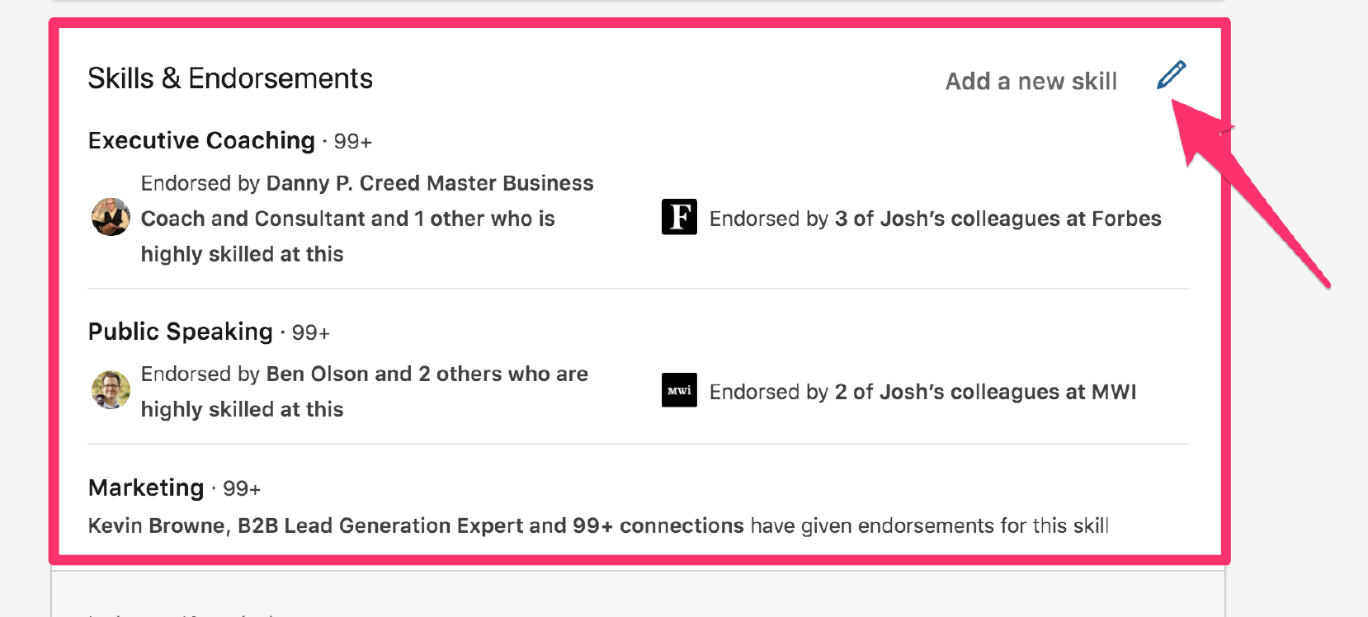
Skills

Slide 40
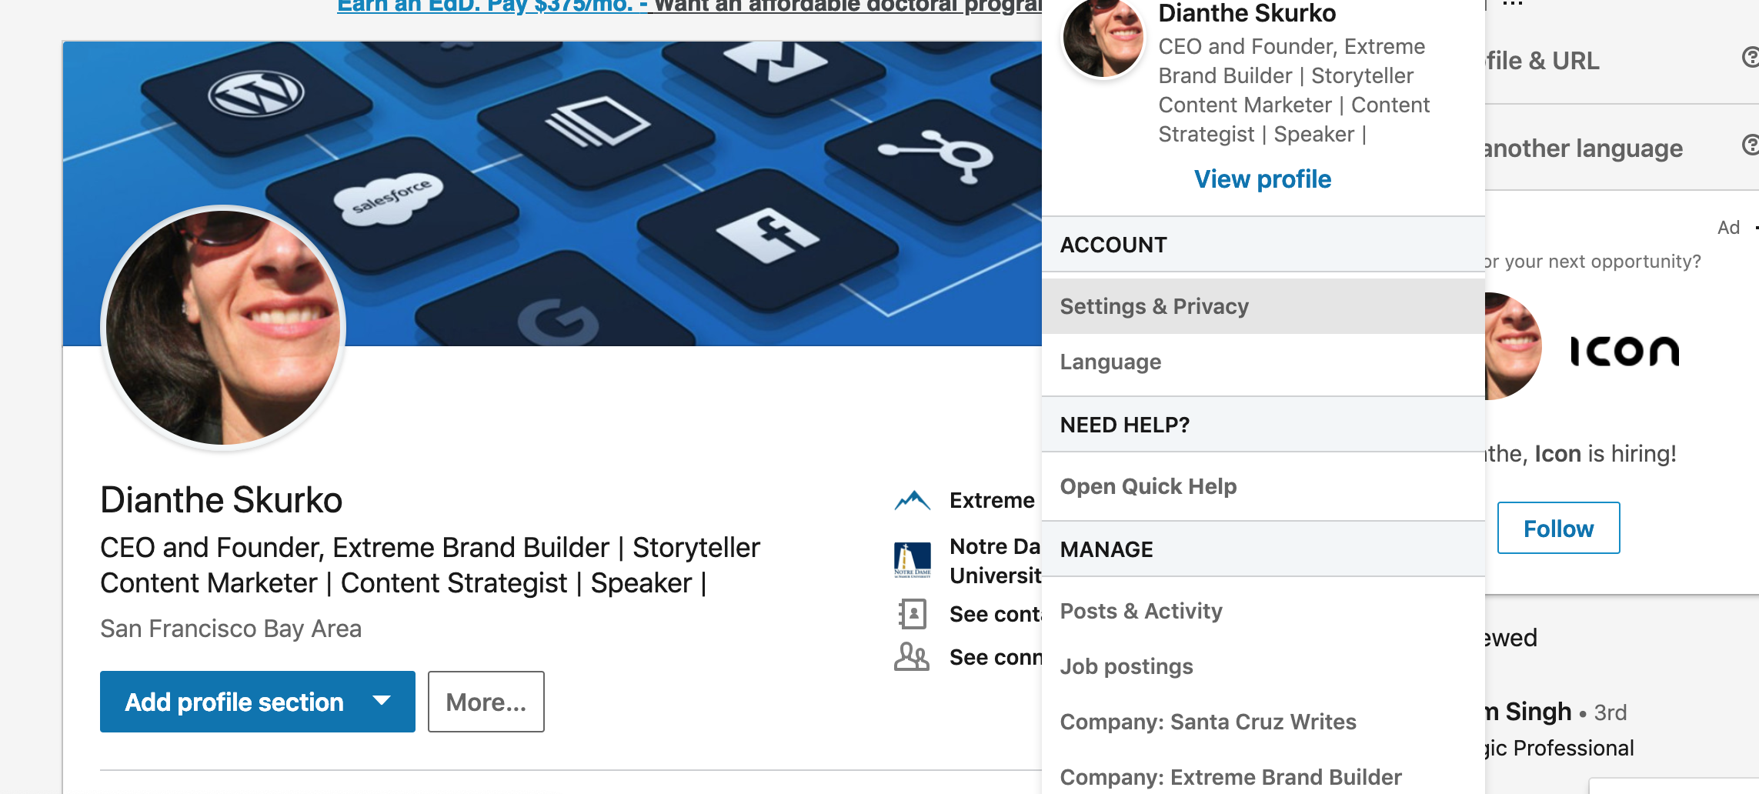
Public Settings

Slide 41
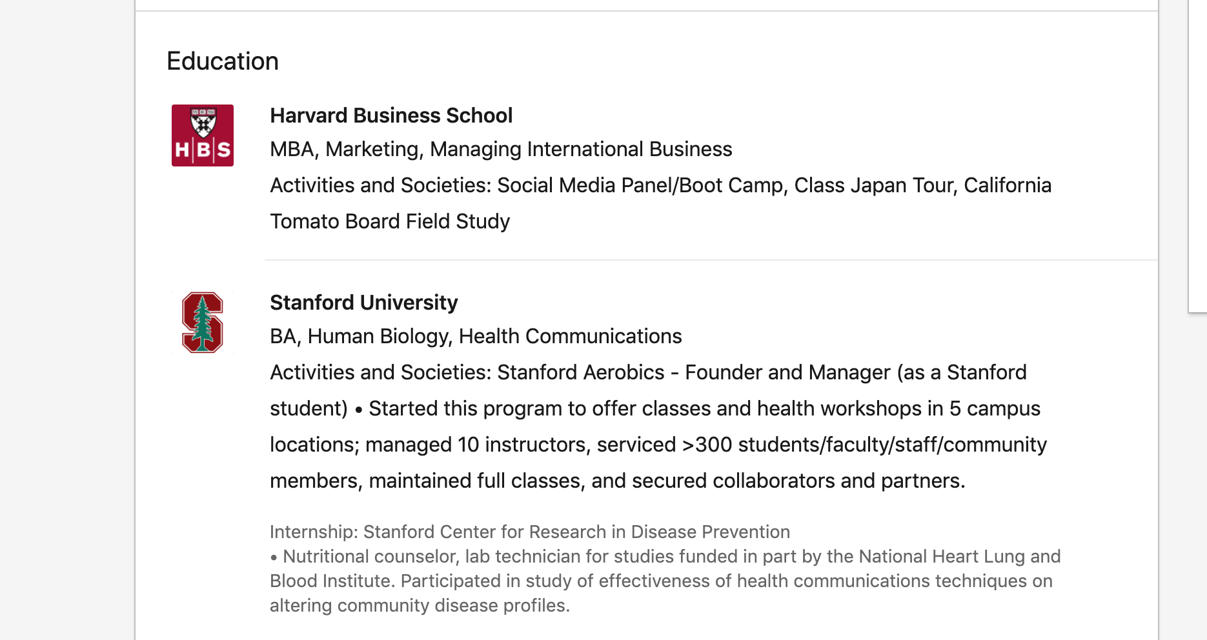
Education

Slide 42
Optimize Your LinkedIn Profile
1. Profile photo
2. Title
3. Banner
4. Bio
5. Job history
6. Contact info
7. Recommendations
8. Skills
9. Public settings
10. Education

Slide 43
Connect with:
Everyone you know
2nd connections who are like you
2nd connections you want to be like
Members of your target audience who are 2nd connections
Groups
Make each invitation personal
DIANTHE SKURKO Extreme Brand Builder

Slide 44
Content Distribution
Post with a purpose

Slide 45
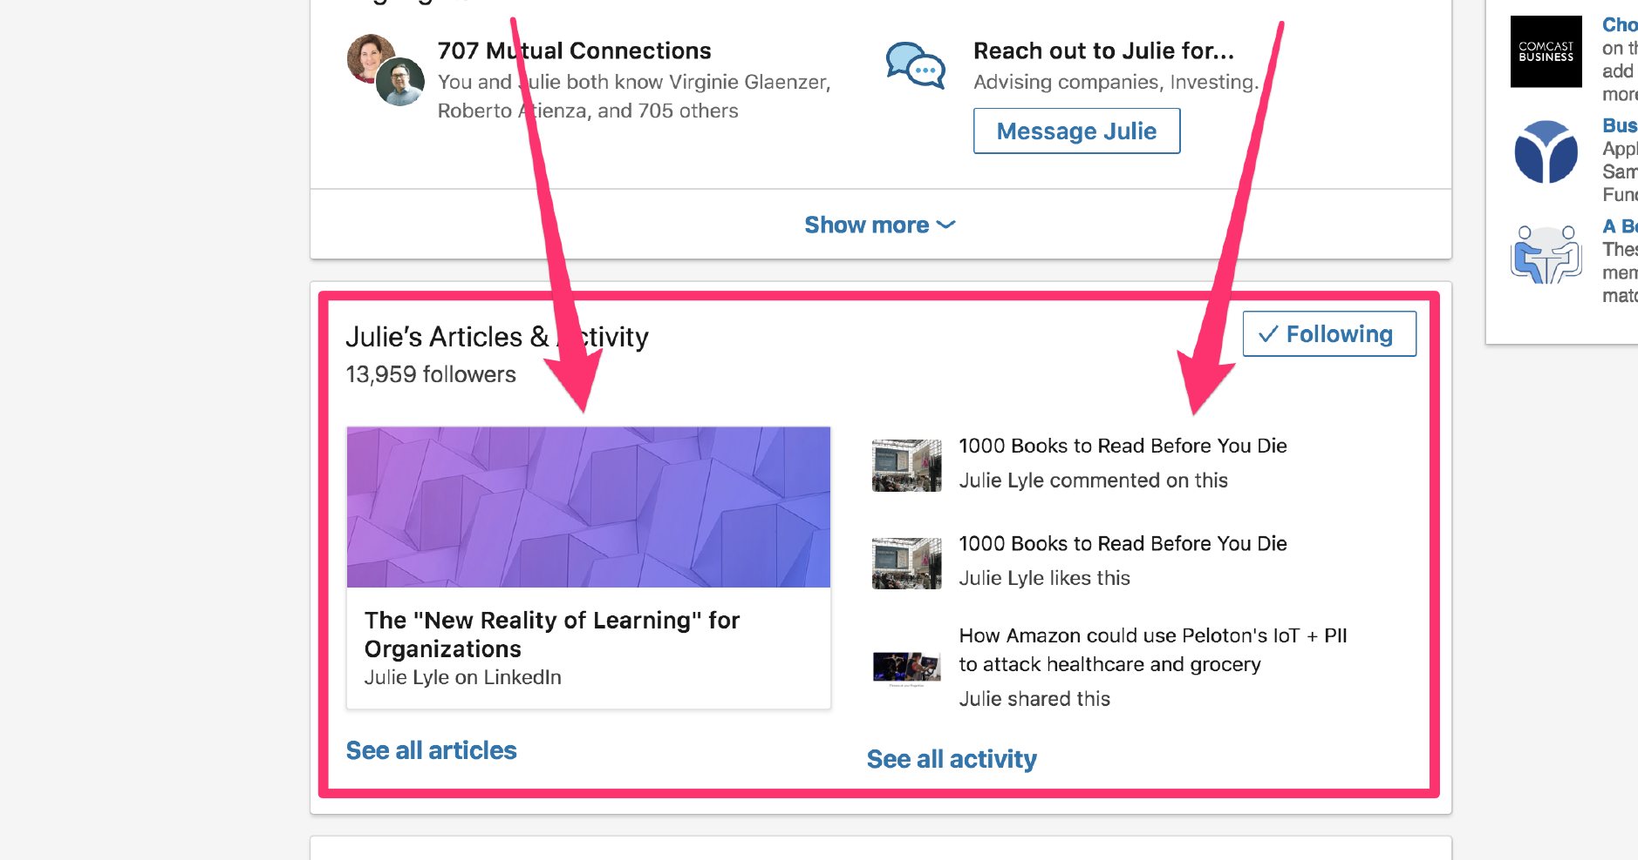
Post Quality Content

Slide 46
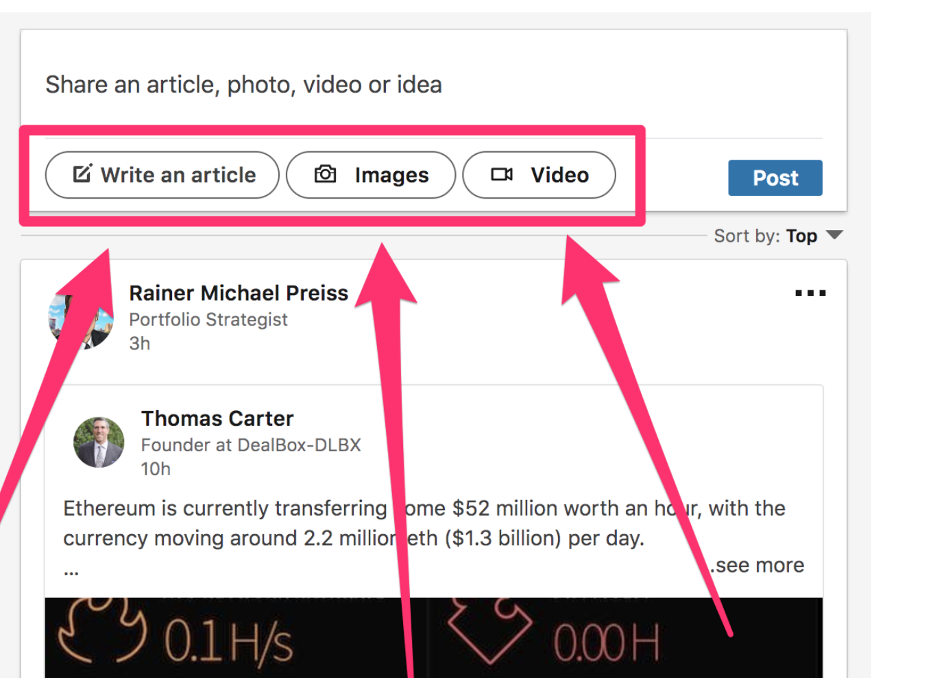
Post Quality Content

Slide 47
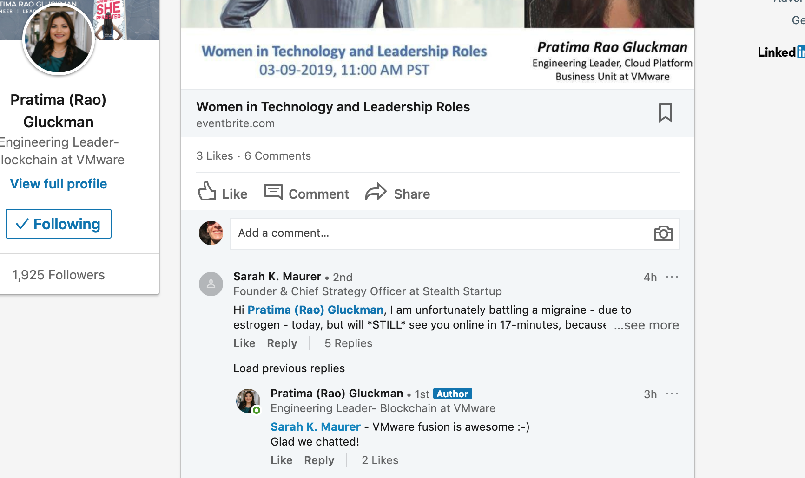
It’s all about the COMMENTS

Slide 48
Discussion Starters
Career or business questions
Career or business answers
Challenges you’ve overcome
Links to articles, books, podcasts
Infographics
Current topics

Slide 49
Review Branding Yourself on LinkedIn
Optimize your profile
Make meaningful connections
Create compelling content

Slide 50
LinkedIn for Entrepreneurs
DIANTHE SKURKO
dianthe@extremebrandbuilder.com
Notes:
Quick overview of branding vs personal branding

Slide 51
Thank You To Our Sponsors
Find This Presentation & Others From This Series At
www.santacruzpl.org/brownbags/

